Slide 1


Chapter 1:
Kubernetes (K8s) Foundations
Microservices Patterns
Agile Brains Consulting
1
©Agile Brains Consulting Inc. All rights reserved. Not to be reproduced without prior written consent.

Slide 2
Table of Content
Advantage of Containers
Need of an Orchestration Tool
Introduction to Microservices
Microservices Patterns
Data management
Communication
Deployment
Reliability

Slide 3
Containers
Containers are becoming the standard unit of deployment
Each container image has
Code
Binaries
Configuration
Libraries
Frameworks
Runtime
Developers and Operators love containers
Agile Brains Consulting
3
©Agile Brains Consulting Inc. All rights reserved. Not to be reproduced without prior written consent.
Notes:
Docker is developer centric technology
Immutable artifact for your application – that can easily be replicated and recreated in many different environments and platforms that has a Linux host. In order to share your application across many machines and development environments.
Each container image has all the things listed and have complete portability across machines and environments that contains docker engine

Slide 4
Containers
Docker has solved the problem of packaging, deploying and running containerized applications
Docker is great for managing a few containers running on a fewer machines
Production applications deal with dozens of containers running on hundreds of machines
Agile Brains Consulting
4
©Agile Brains Consulting Inc. All rights reserved. Not to be reproduced without prior written consent.
Notes:
Docker is great for running few containers or a collection and is built around abstraction on single machine.
When you move to production – you start dealing with distributed system challenges that require much more sophisticated tooling

Slide 5
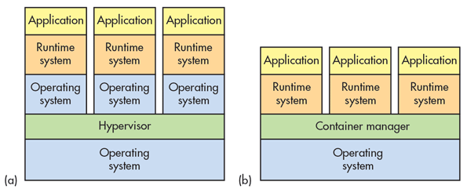
Container Advantages
Portable
Isolated
Lighter footprint & overhead (vs VMs)
Simplify DevOps practices
Speed up Continuous Integration
Empower Microservice architectures and adoption
Agile Brains Consulting
5
©Agile Brains Consulting Inc. All rights reserved. Not to be reproduced without prior written consent.

Slide 6
2.1 Why need container orchestration
Agile Brains Consulting
6
©Agile Brains Consulting Inc. All rights reserved. Not to be reproduced without prior written consent.

Slide 7
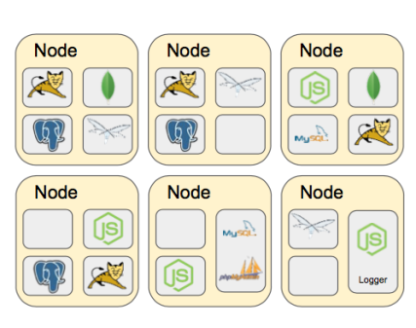
Challenges with multiple containers
How to scale?
Once I scale, where are they?
How do my containers find each other?
How should I manage port conflicts?
What if a host fails?
How to update them? Health checks?
How will I track their logs?
Agile Brains Consulting
7
©Agile Brains Consulting Inc. All rights reserved. Not to be reproduced without prior written consent.

Slide 8
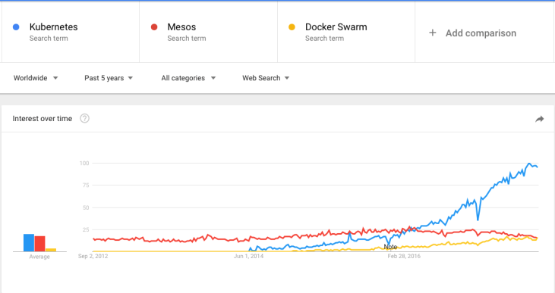
Container Orchestration Tools
The three most popular are: Kubernetes, Docker Swam & Mesos
Kubernetes has become the unofficial standard
Agile Brains Consulting
8
©Agile Brains Consulting Inc. All rights reserved. Not to be reproduced without prior written consent.
Notes:
Google started creation of its own open source orchestration tool ‘Kubernetes’. It has slowly gained dominance as the standard container orchestration tool except for niche use cases.
Mesos
Still used in early container adoption shops and big data applications
Docker Swarm
Lightweight and may be useful for rapid prototyping. With the ease of deploying Kubernetes to public cloud and greater feature set of Kubernetes this use case is increasingly shrinking.

Slide 9
Introduction to Microservices and design patterns in Microservices
Agile Brains Consulting
9
©Agile Brains Consulting Inc. All rights reserved. Not to be reproduced without prior written consent.

Slide 10
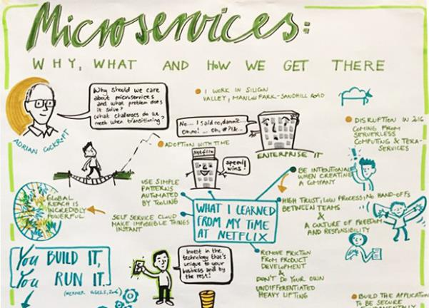
Microservices Overview
Microservices is defined as a loosely-coupled, service-oriented architecture with bounded context.
Agile Brains Consulting
10
©Agile Brains Consulting Inc. All rights reserved. Not to be reproduced without prior written consent.

Slide 11
Microservices – Why do we need
Context Switching
Dependency management
Multiple hand-offs
Less Frequent Updates
Slow Velocity
App becomes complex
Agile Brains Consulting
11
©Agile Brains Consulting Inc. All rights reserved. Not to be reproduced without prior written consent.

Slide 12
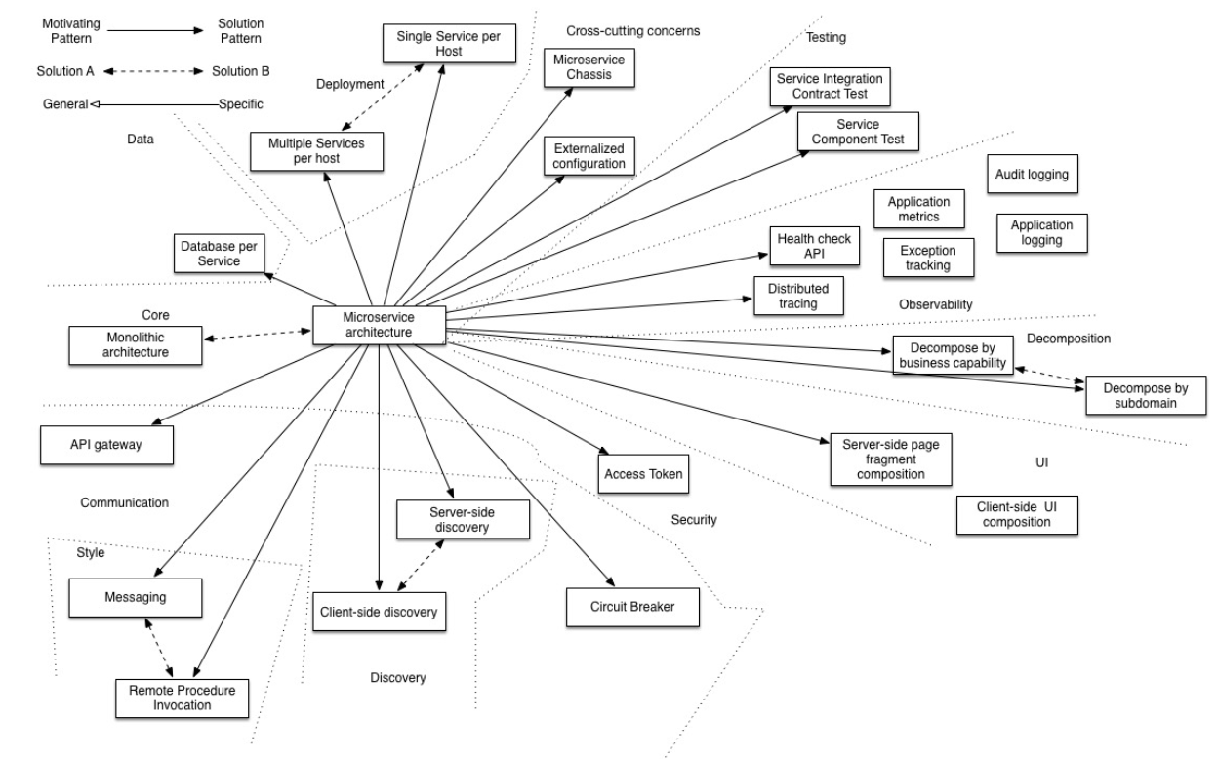
Microservices – Patterns
Agile Brains Consulting
12
©Agile Brains Consulting Inc. All rights reserved. Not to be reproduced without prior written consent.

Slide 13
Pattern – Categories
Data Management
Communication
Deployment
Discovery
Reliability
Observability
Testing
Agile Brains Consulting
13
©Agile Brains Consulting Inc. All rights reserved. Not to be reproduced without prior written consent.
Notes:
Private tables per service may be a middle ground between the two approaches, but care must be taken to enforce access controls.
Further Reading:
http://microservices.io/patterns/data/database-per-service.html
http://microservices.io/patterns/data/shared-database.html

Slide 14
Data Management Patterns
Shared database
Database per Service
Saga
Event Sourcing
CQRS (Command Query Responsibility Segregation)
API Composition
Agile Brains Consulting
14
©Agile Brains Consulting Inc. All rights reserved. Not to be reproduced without prior written consent.
Notes:
Private tables per service may be a middle ground between the two approaches, but care must be taken to enforce access controls.
Further Reading:
http://microservices.io/patterns/data/database-per-service.html
http://microservices.io/patterns/data/shared-database.html

Slide 15
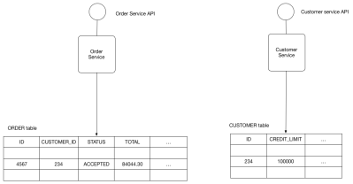
Shared Database
Shared Database
Use a (single) database shared by multiple services. Local ACID transactions.
Benefits:
Straightforward ACID transactions to enforce data consistency
Single database is simpler to operate
Drawbacks:
Since all services access the same database, interference and transaction locks on the table.
Single database might not satisfy the data storage and requirements of all services.
Agile Brains Consulting
15
©Agile Brains Consulting Inc. All rights reserved. Not to be reproduced without prior written consent.
Notes:
Private tables per service may be a middle ground between the two approaches, but care must be taken to enforce access controls.
Further Reading:
http://microservices.io/patterns/data/database-per-service.html
http://microservices.io/patterns/data/shared-database.html

Slide 16
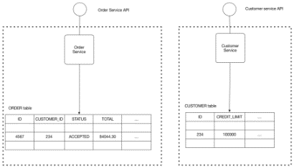
Database Per Service
Database Per Service
Every Microservice has its own persistent data and accessible only via its API
E.g. Private-tables-per-service; Schema-per-service; Database-server-per-service
Benefits:
Ensures loose coupling
Each service can use the type of database that is best suited to its needs. E.g., text searches could use ElasticSearch; social graph could use Neo4j.
Drawbacks:
Transactions involving multiple services not straight forward
For consistency; may need to implement capability to roll back (Saga pattern)
Interaction is achieved by message/event brokers
Agile Brains Consulting
16
©Agile Brains Consulting Inc. All rights reserved. Not to be reproduced without prior written consent.
Notes:
Private tables per service may be a middle ground between the two approaches, but care must be taken to enforce access controls.
Further Reading:
http://microservices.io/patterns/data/database-per-service.html
http://microservices.io/patterns/data/shared-database.html

Slide 17
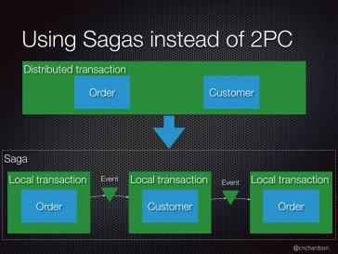
Saga Pattern – For Data Consistency
A Saga represents a high-level business process (such as booking a trip) that consists of several low-level Requests that each update data within a single service.
Each Request has a Compensating Request that is executed when the Request fails or the saga is aborted.
** How to reliably/atomically publish events whenever state changes? Solution can be Event Sourcing
Agile Brains Consulting
17
©Agile Brains Consulting Inc. All rights reserved. Not to be reproduced without prior written consent.
Notes:
Further Reading:
http://microservices.io/patterns/data/saga.html
http://microservices.io/patterns/data/api-composition.html

Slide 18
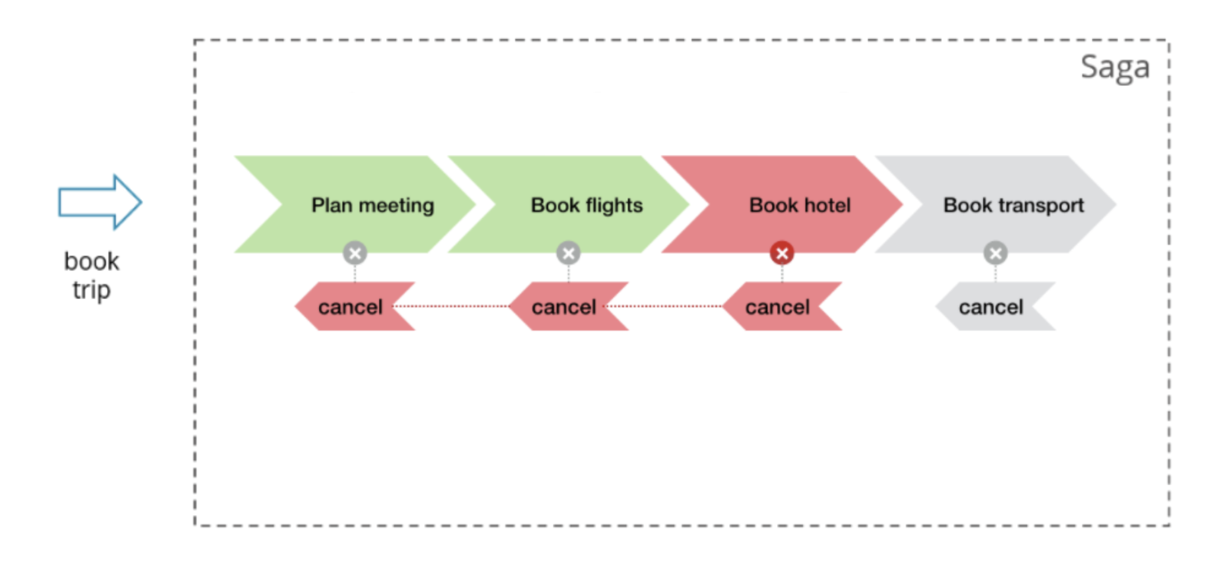
Saga Pattern – For Data Consistency
Saga Pattern is designed for failures and consist of 2 request group
Collection of request: e.g. {Book Flight}, {Book Hotel}, {Book Transport}
Collection of compensating request. E.g. {XX, cancel flight, cancel hotel }
Asynchronous request: It may happen that the compensating request arrives before its corresponding request, thus bookhotel arrives later than cancelhotel.
** How to reliably/atomically publish events whenever state changes? Solution can be Event Sourcing
Agile Brains Consulting
18
©Agile Brains Consulting Inc. All rights reserved. Not to be reproduced without prior written consent.
Notes:
Further Reading:
http://microservices.io/patterns/data/saga.html
http://microservices.io/patterns/data/api-composition.html

Slide 19
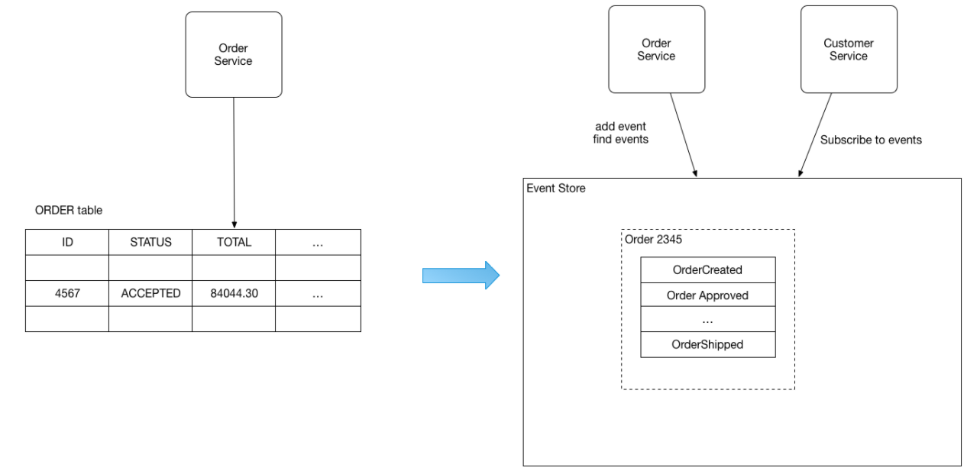
Event Sourcing
Persists the state of a business entity as a sequence of state-changing events – in Event Store
The store has APIs for adding, retrieving an entity’s events and subscribe to events.
The store is like a message broker; A new event is delivered to all interested subscribers.
E.g. the Order is saved as sequence of events, and customerService subscribe to those events
Benefits:
reliably publish events whenever state changes
Drawbacks:
Difficult to design (unconventional)
The event store is difficult to query since it requires typical queries to reconstruct the state of the business entities - complex and inefficient --- use CQRS to query
Agile Brains Consulting
19
©Agile Brains Consulting Inc. All rights reserved. Not to be reproduced without prior written consent.
Notes:
Further Reading:
http://microservices.io/patterns/data/saga.html
http://microservices.io/patterns/data/api-composition.html

Slide 20
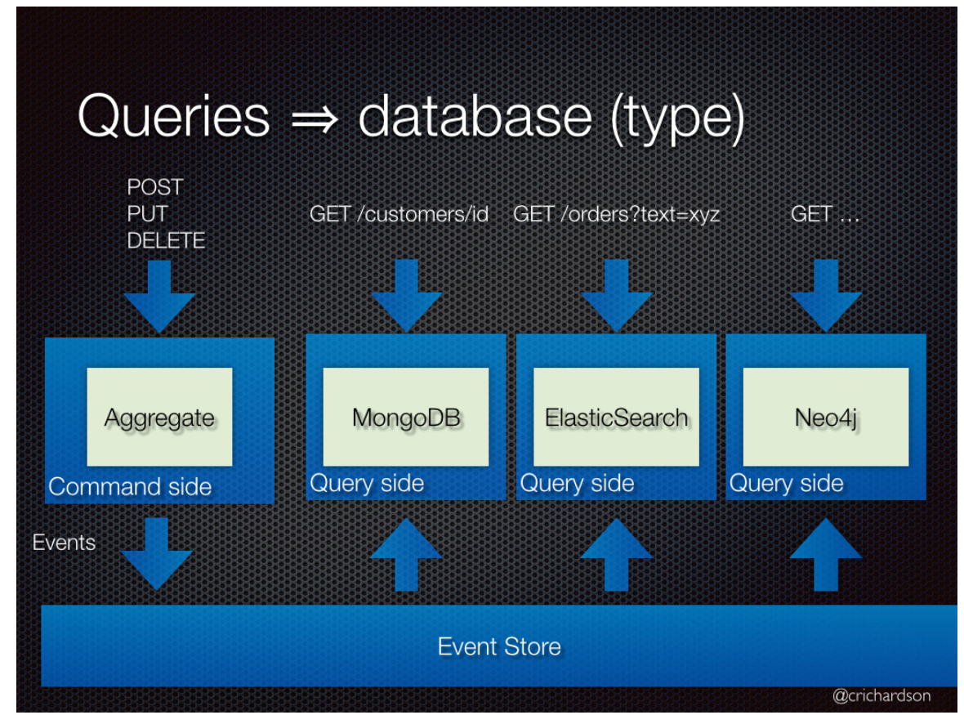
CQRS –
Command Query Responsibility Segregation
Split the application into two parts:
Command-side: handles create, update, and delete requests and emits events when data changes.
Query-side: handles queries by executing them against one or more materialized views that are kept up to date by subscribing to the stream of events emitted when data changes.
A Command cannot return data and
a Query cannot change the data.
Use Case
Get data from multiple different Aggregates
Application has an imbalance in responsibility (read/writes)
How to
Two models talking to same date store (applications that require synchronous processing and immediate results.)
Two models talking to different data store (Eventual Consistency)
Agile Brains Consulting
20
©Agile Brains Consulting Inc. All rights reserved. Not to be reproduced without prior written consent.
Notes:
Further Reading:
http://microservices.io/patterns/data/saga.html
http://microservices.io/patterns/data/api-composition.html

Slide 21
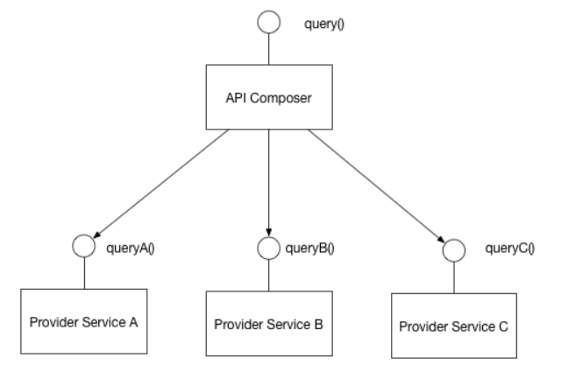
API Composition
Perform queries in Microservices architecture
Implement a query by defining an API Composer, which invoking the services that own the data and performs an in-memory join of the results.
Benefits:
It a simple way to query data in a Microservice architecture
Drawbacks:
Some queries would result in inefficient, in-memory joins of large datasets.
Agile Brains Consulting
21
©Agile Brains Consulting Inc. All rights reserved. Not to be reproduced without prior written consent.
Notes:
Further Reading:
http://microservices.io/patterns/data/saga.html
http://microservices.io/patterns/data/api-composition.html

Slide 22
Pattern – Categories
Data Management
Communication
Deployment
Discovery
Reliability
Observability
Testing
Agile Brains Consulting
22
©Agile Brains Consulting Inc. All rights reserved. Not to be reproduced without prior written consent.

Slide 23
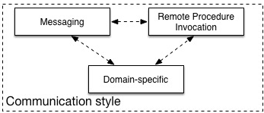
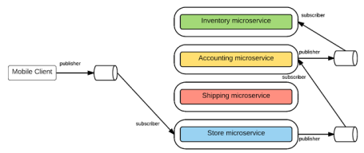
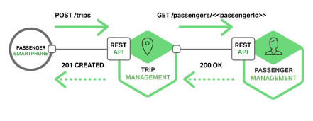
Communication Style
Messaging
Services communicate by sending asynchronous messages
Decouples client & service
Must also install and maintain a broker (Kafka, RabbitMQ, etc)
Complex and should be highly available
Remote Procedure Invocation
Simple and familiar
Both client and service must be available
Only simple request and reply. Notifications, publish/subscribe, async communication not supported
E.g. Rest, Thrift
Agile Brains Consulting
23
©Agile Brains Consulting Inc. All rights reserved. Not to be reproduced without prior written consent.
Notes:
Domain specific protocol
Email such as SMTP or IMAP
Media streaming such as RTMP, HLS, etc
Further Reading:
http://microservices.io/patterns/communication-style/rpi.html
http://microservices.io/patterns/communication-style/messaging.html
http://microservices.io/patterns/communication-style/domain-specific.html

Slide 24
Pattern – Categories
Data Management
Communication
Deployment
Discovery
Reliability
Observability
Testing
Agile Brains Consulting
24
©Agile Brains Consulting Inc. All rights reserved. Not to be reproduced without prior written consent.

Slide 25
Deployment Patterns
Service instance per host
Multiple Service instance per host
Service instance per VM
Service instance per container
Server-less
Agile Brains Consulting
25
©Agile Brains Consulting Inc. All rights reserved. Not to be reproduced without prior written consent.

Slide 26
Pattern – Categories
Data Management
Communication
Deployment
Discovery
Reliability
Observability
Testing
Agile Brains Consulting
26
©Agile Brains Consulting Inc. All rights reserved. Not to be reproduced without prior written consent.

Slide 27
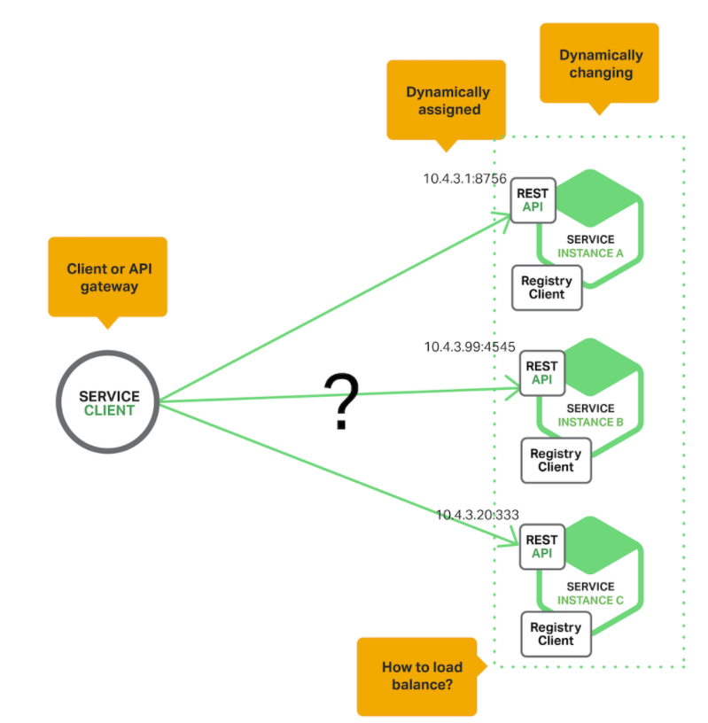
Service Discovery
Service instances have dynamically assigned network locations. Moreover, the set of service instances changes dynamically because of autoscaling, failures, and upgrades. Consequently, the client code needs to use a more elaborate service discovery mechanism.
Agile Brains Consulting
27
©Agile Brains Consulting Inc. All rights reserved. Not to be reproduced without prior written consent.
Notes:
https://www.nginx.com/blog/service-discovery-in-a-microservices-architecture/
Discovery is one of the first issues encountered when implementing microservices. One of Kubernetes initial innovations was a DNS method for services to communicate with one another. Nearly every modern microservice platform has its own service discovery method that is a variant of one discussed here.
Fewer moving parts than Server side service discovery, but couples the client to the Service Registry.
Further Reading:
http://microservices.io/patterns/client-side-discovery.html

Slide 28
Service Registry
Key of service discovery
Database containing the network locations of service instances.
Needs to be highly available and up to date.
Clients can cache network locations obtained from the service registry -- that information eventually becomes out of date
A service registry consists of a cluster of servers that use a replication protocol to maintain consistency.
E.g. Netflix Eureka, consul, Zookeeper, etcd
https://github.com/hashicorp/consul-template -- dynamically reconfigure NGINX nginx.conf
Agile Brains Consulting
28
©Agile Brains Consulting Inc. All rights reserved. Not to be reproduced without prior written consent.
Notes:
https://www.nginx.com/blog/service-discovery-in-a-microservices-architecture/

Slide 29
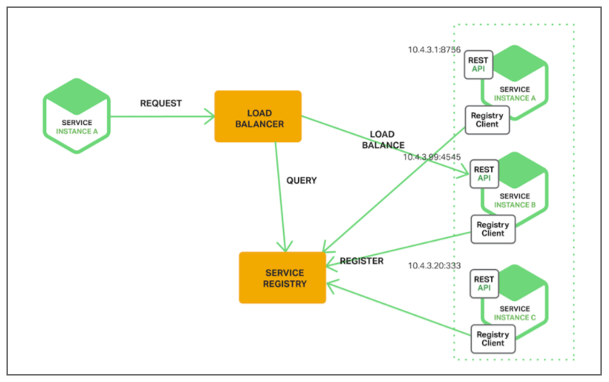
Service Discovery Pattern
The client makes a request to a service via a load balancer. The load balancer queries the service registry and routes each request to an available service instance. As with client‑side discovery, service instances are registered and deregistered with the service registry.
E.g. Kubernetes, Mesos, AWS Elastic LoadBalancer
Agile Brains Consulting
29
©Agile Brains Consulting Inc. All rights reserved. Not to be reproduced without prior written consent.
Notes:
https://www.nginx.com/blog/service-discovery-in-a-microservices-architecture/

Slide 30
Pattern – Categories
Data Management
Communication
Deployment
Discovery
Reliability
Observability
Testing
Agile Brains Consulting
30
©Agile Brains Consulting Inc. All rights reserved. Not to be reproduced without prior written consent.

Slide 31
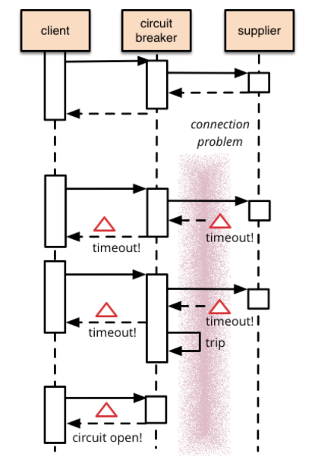
Circuit Breaker
Reason:
Remote calls can fail, reach timeout due to unresponsive supplier.
Increased number of calls may lead to cascading failures across multiple systems
What is it:
Wrap a protected function call in a circuit breaker object, which monitors for failures. Once the failures reach a certain threshold, the circuit breaker trips, and all further calls to the circuit breaker return with an error, without the protected call being made at all.
Agile Brains Consulting
31
©Agile Brains Consulting Inc. All rights reserved. Not to be reproduced without prior written consent.

Slide 32
Pattern – Categories
Data Management
Communication
Deployment
Discovery
Reliability
Observability
Testing
Agile Brains Consulting
32
©Agile Brains Consulting Inc. All rights reserved. Not to be reproduced without prior written consent.

Slide 33
Observability Patterns
Application Metrics
Health check API
Distributed Tracing
Exception Tracking
Log aggregation
Audit Logging
Agile Brains Consulting
33
©Agile Brains Consulting Inc. All rights reserved. Not to be reproduced without prior written consent.

Slide 34
Observability Metrics
USE (Utilization, Saturation, Error) method (Brendan Gregg)
For every resource, check
Utilization: average time that the resource was busy servicing work
Example: One disk is running at 90%
Saturation: the degree to which the resource has extra work which it can’t service, often queued
Example: The CPUs have an average run queue length of four
Error count (rate): the count of error events
Example: This network interface has had fifty late collisions
Useful for resources such as queues, CPU’s, memory, interconnects, etc.
Agile Brains Consulting
34
©Agile Brains Consulting Inc. All rights reserved. Not to be reproduced without prior written consent.
Notes:
http://www.brendangregg.com/usemethod.html

Slide 35
Observability Metrics
RED method (Tom Wilkie)
For every service, check
Request count (rate)
Error count (rate)
Duration
Note:
Observability = Logging + Monitoring + Tracing + Visualization
All good instrumentation libraries (Prometheus, Graphite, etc.) have at least three main primitives
Counter: records events that happen such as incoming requests, bad requests, errors, etc.
Gauge: records things that fluctuate over time such as the size of a thread pool
Histogram: records observations of scalar quantities of events such as request durations
Agile Brains Consulting
35
©Agile Brains Consulting Inc. All rights reserved. Not to be reproduced without prior written consent.
Notes:
http://www.brendangregg.com/usemethod.html

Slide 36
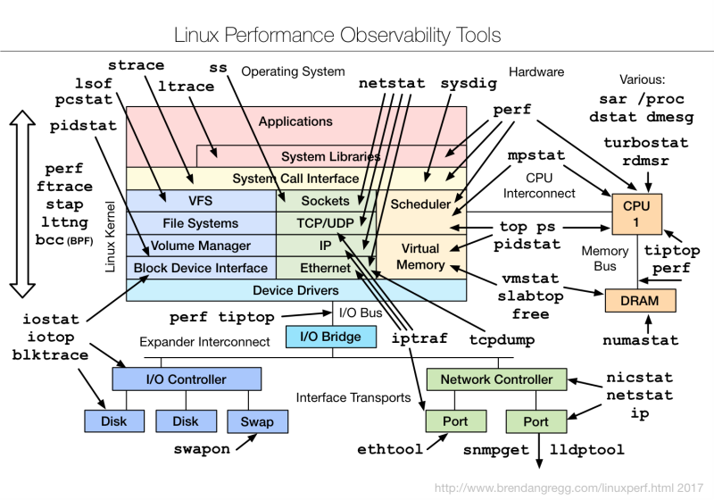
Agile Brains Consulting
36
©Agile Brains Consulting Inc. All rights reserved. Not to be reproduced without prior written consent.
Notes:
http://www.brendangregg.com/linuxperf.html

Slide 37
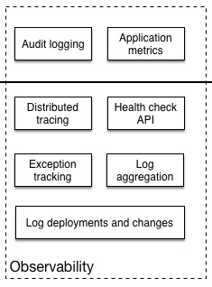
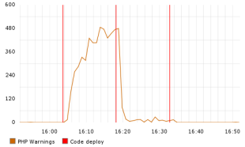
Observability (Exception Tracking)
Log deployments and changes
Track changes as they are opportunities for failure
For example, tracking deployments and changes so they can be easily correlated with issues later for faster resolution
Exception Tracking
It is crucial to save errors and the corresponding stack trace
Ideally, exceptions are de-duplicated and recorded for further aggregation and investigation
*Etsy graphing error rates against new code deployments
Agile Brains Consulting
37
©Agile Brains Consulting Inc. All rights reserved. Not to be reproduced without prior written consent.
Notes:
http://microservices.io/patterns/observability/exception-tracking.html
https://codeascraft.com/2010/12/08/track-every-release/

Slide 38
Observability (Aggregation and Audit)
Log Aggregation
Requests span multiple instances over multiple machines. It is important to gather information in a standardized format
Log files contain errors, warnings, and debug information
It is important to aggregate, search and analyze such logs
Popular solutions for this include the ELK stack (Elastic Search, Logstash and Kibana) and AWS Cloud Watch
Audit Logging
It is vital to know actions a user has performed.
For security and compliance, this is often a must have
Average time to detect intrusions is 98 days for financial services, 197 days for retail, it should/can be much lower
Agile Brains Consulting
38
©Agile Brains Consulting Inc. All rights reserved. Not to be reproduced without prior written consent.
Notes:
Days to intrusion: http://www.zdnet.com/article/businesses-take-over-six-months-to-detect-data-breaches/
http://microservices.io/patterns/observability/audit-logging.html
http://microservices.io/patterns/observability/application-logging.html

Slide 39
Logging best practices
Log output as a set of JSON key/value pairs instead of pure text
Easier for computer to test and aggregate
Easier to make rules and query
Comprehensive
Do this:
“Timestamp: 2017-09-01 1:25”, ”caller”:”main.go:5”, “transport”:”HTTP”,”addr”:”8080”
Not this
“2017-09-01 1:25 main.go 5 HTTP 8080”
Agile Brains Consulting
39
©Agile Brains Consulting Inc. All rights reserved. Not to be reproduced without prior written consent.

Slide 40
Pattern – Categories
Data Management
Communication
Deployment
Discovery
Observability
Testing
Agile Brains Consulting
40
©Agile Brains Consulting Inc. All rights reserved. Not to be reproduced without prior written consent.

Slide 41
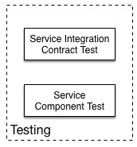
Service Integration/Component Testing
Service Integration Tests
End-to-end testing is slow and expensive
Test the APIs (functionality) provided by services
Black box testing
Service Component Tests
Test the components of the service
A test suite that tests a service in isolation using test doubles for any services that it invokes.
A/B testing
Agile Brains Consulting
41
©Agile Brains Consulting Inc. All rights reserved. Not to be reproduced without prior written consent.

Slide 42
End-To-End tests Vs Unit Test
End-to-end tests: time taking and expensive
The dev team might have to spend weeks finding all the issues breaking the end-to-end test
They would be better served with a large base of unit test that find bugs quickly
Slow
No isolated failures
Simulates a real user
Unit Tests: Fast and cheap
Unit tests should form the majority of tests as they quickly identify bugs and represent a fast feedback loop
When a Unit test fails, the function and area that fails is much narrower in scope than broad end-to-end tests
Fast
Isolated Failures
But do not simulates a real user
Agile Brains Consulting
42
©Agile Brains Consulting Inc. All rights reserved. Not to be reproduced without prior written consent.
Notes:
Reference: https://testing.googleblog.com/2015/04/just-say-no-to-more-end-to-end-tests.html
Analysis
Despite numerous problems, the tests ultimately did catch real bugs. What Went Well
Customer-impacting bugs were identified and fixed before they reached the customer.
What Went Wrong
The team completed their coding milestone a week late (and worked a lot of overtime).
Finding the root cause for a failing end-to-end test is painful and can take a long time.
Partner failures and lab failures ruined the test results on multiple days.
Many smaller bugs were hidden behind bigger bugs.
End-to-end tests were flaky at times.
Developers had to wait until the following day to know if a fix worked or not.

